Slide 1
Sprint 4
Anna Nardelli, Neil Swagger, Connor Vidnansky, Andrew Welde

Slide 2
Roles
Anna
Leader, Parts 1-4 of Design Document, Gantt Chart
Neil
Code, Test Plan
Connor
Flowchart
Andrew
Algorithm

Slide 3

Video

Slide 4
Challenges
Communication
Technology and Glitches
Time Management
Cooperation from the Robot
Organization

Slide 5
Software Engineering
We learned how to code
Difficulties involved
Team work needed
Importance of communication
Software engineering is more than just writing code
Problem solving

Slide 6
What We Would Do Differently
Besides being able to meet in person
Text each other more about the problems
Create better communications for each sprint
More online meeting, Zoom calls

Slide 7
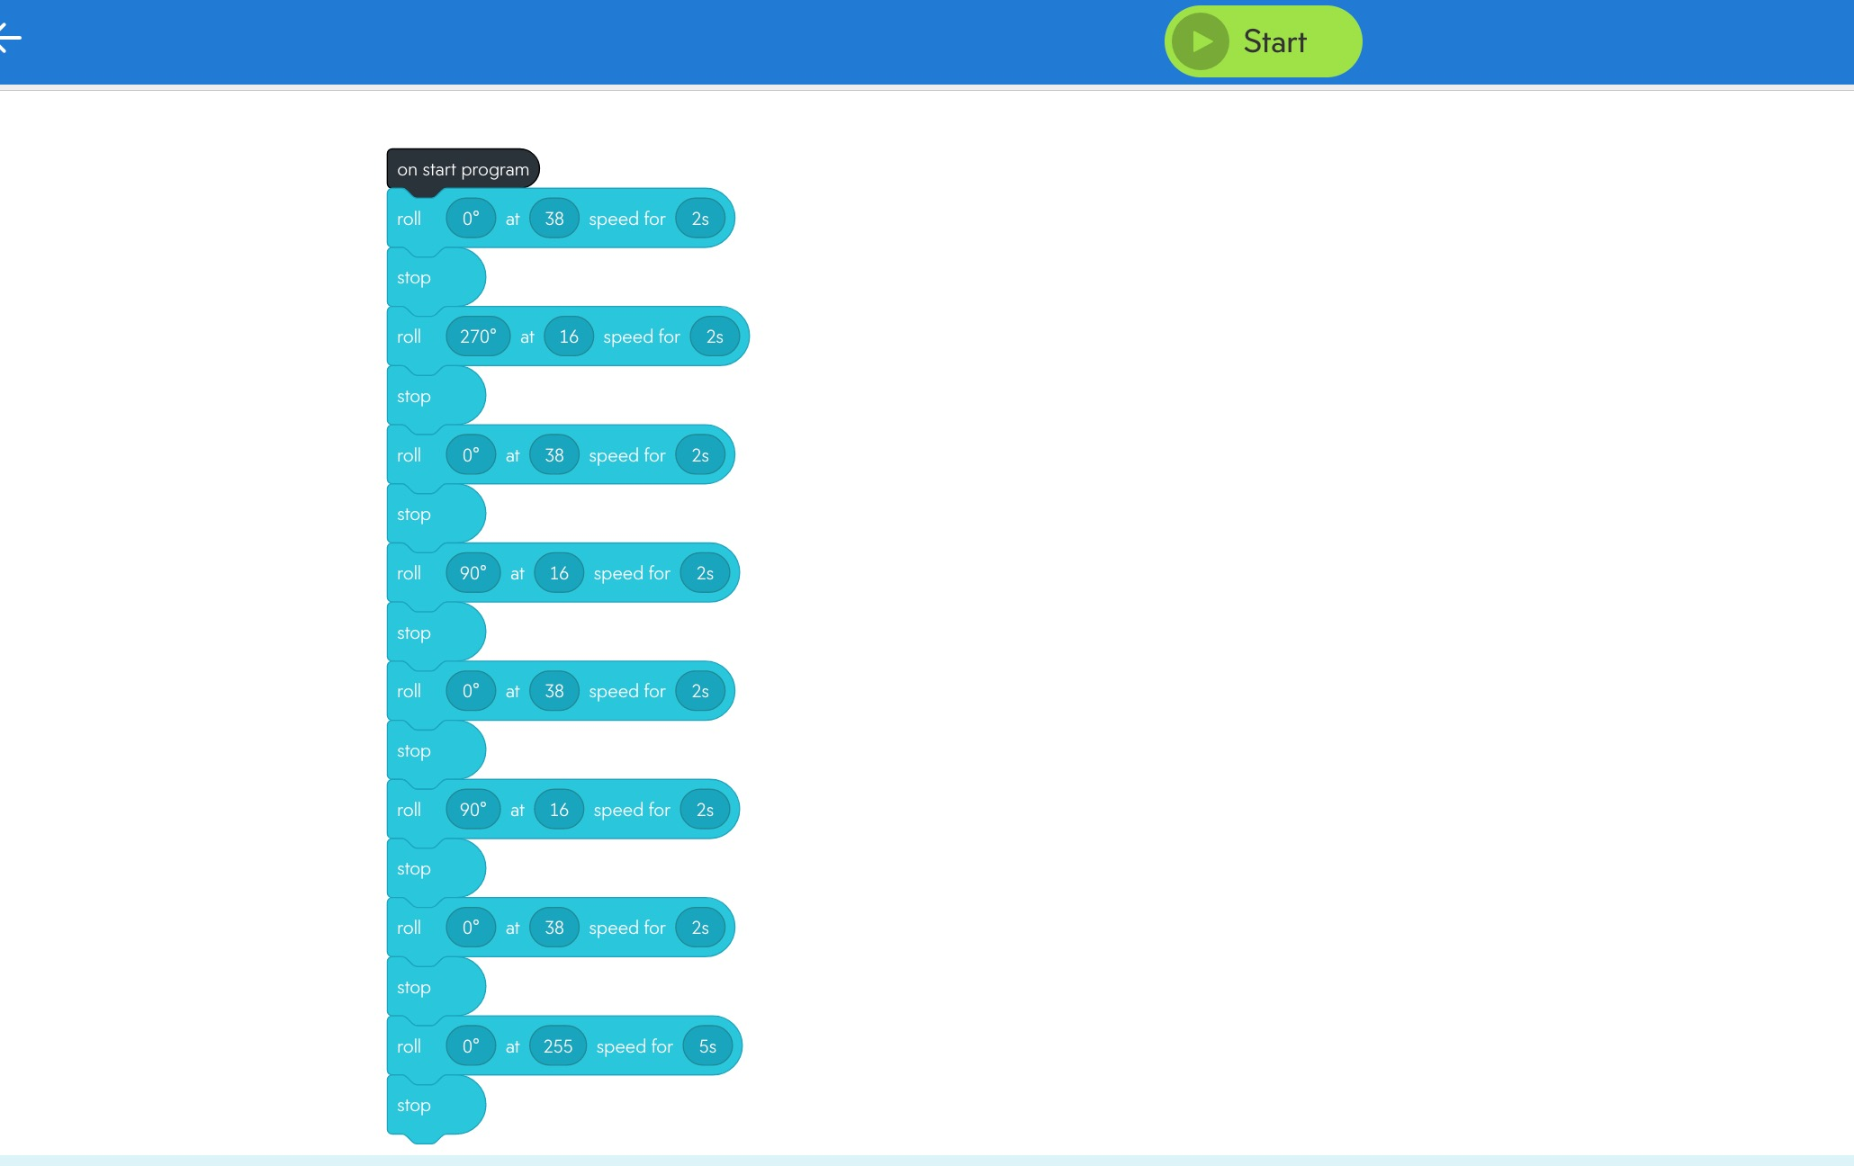
Code for Sprint 3

